Slide 1
E-Cigarettes

Slide 5
Change in Attitudes

Slide 6
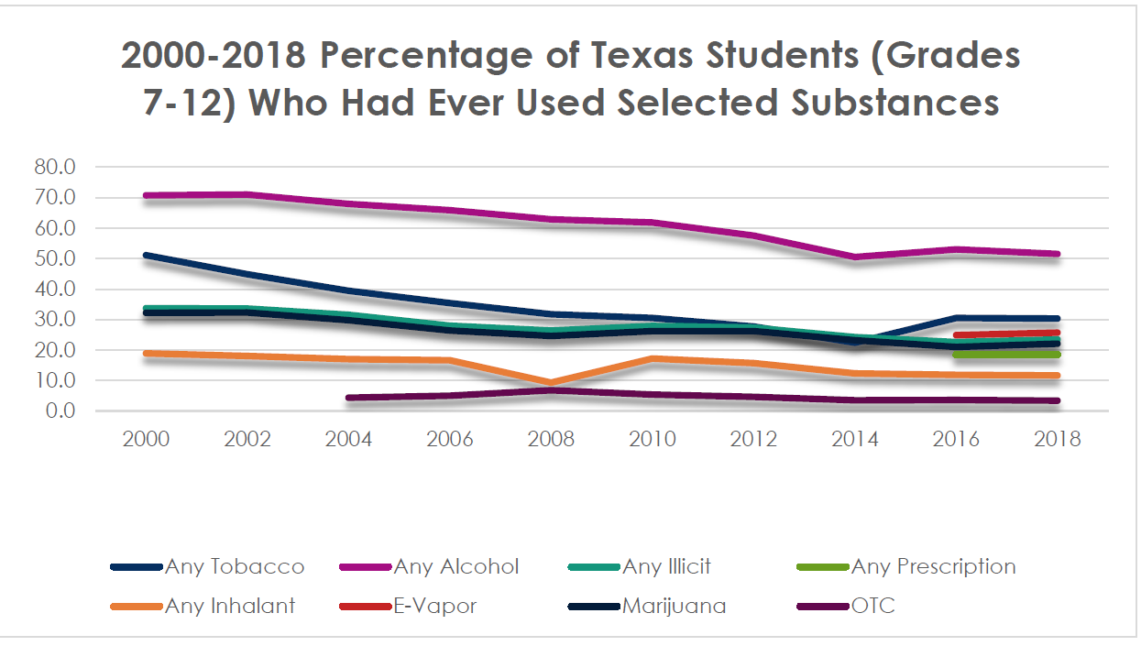

Slide 7
What they are
Heats a liquid to generate an aerosol that the user inhales
Semi-regulated
Aggressively marketed to young, non-smokers

Slide 8
Risks
Popcorn lung
Vomiting/nausea
Pneumonia
1 Juul pod = 1 pack of cigarettes
Lung failure
Injury due to explosion

Slide 9
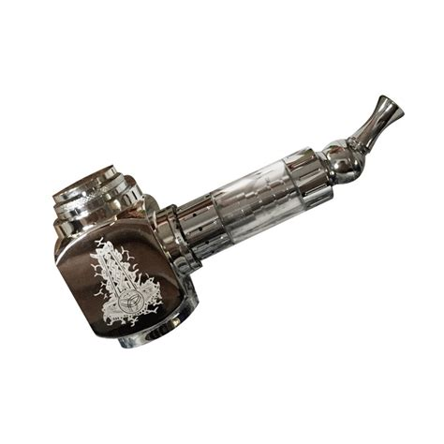
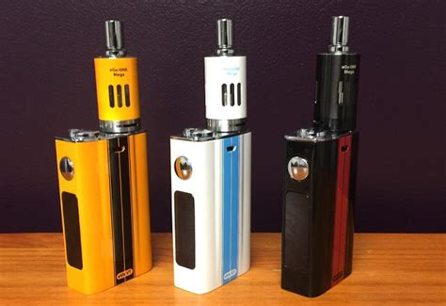
Tanks & Mods

Slide 10
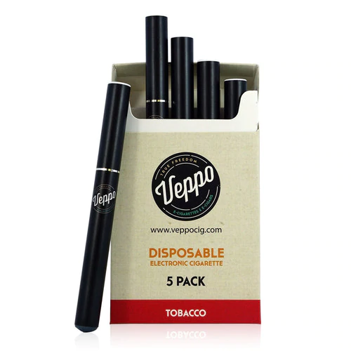
Disposables

Slide 11
Pods

Slide 12
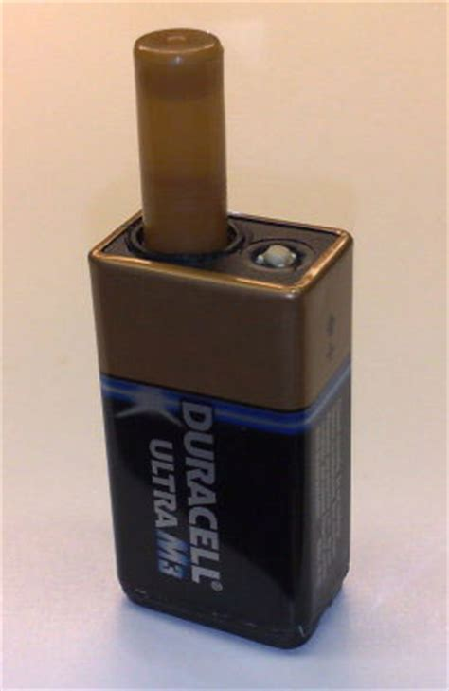
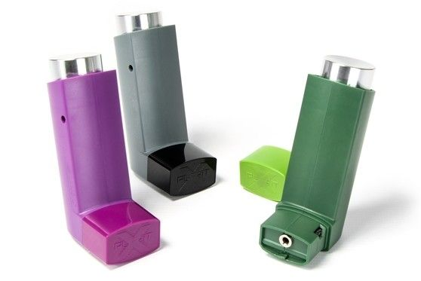
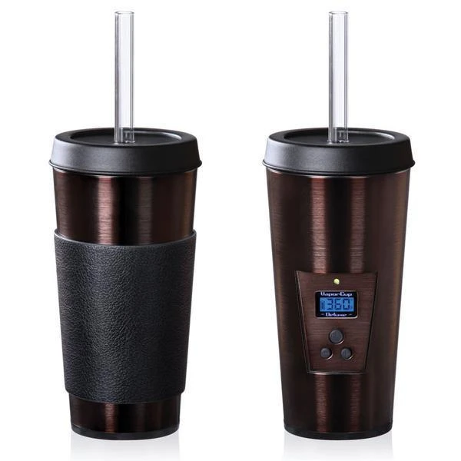
Hidden in Plain Sight

Slide 13
Poisoning our kids
¼ of a teaspoon enough to kill a 50 lbs. child
2014 Poison Control averaged 215 e-cig related calls a week

